Slide 1
Taking the
Password Skills and
Password Skills Solo
Tests

Slide 2
Overall Structure
Two parts
Part 1
  Reading test (75 minutes)
  Writing test (30 minutes)
Part 2
  Listening test (60 minutes)
  Speaking test (20 minutes)
The second part may be taken immediately after the first or following a break, your invigilator will advise you.
For a one part test, all four modules will be taken with one login.
Notes:
S

Slide 3

Login Page
The invigilator may have already entered the login details in which case you will not see this page.
Otherwise, enter the login and password as instructed by the invigilator. Only click on “login” when told to do so by the invigilator.
Do not click on “check tests remaining”.
Notes:
K,KW
KRW
S, SS
SR

Slide 4
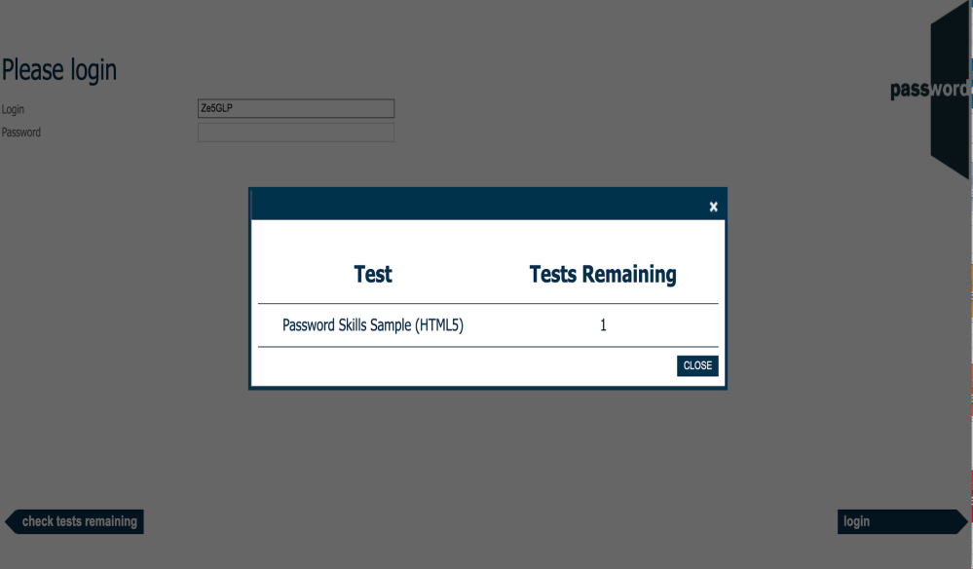
Tests Remaining Page
If you click on “check attempts remaining” by mistake, you will see a page like this (the name of your test may be different).
Click on the “X” or “CLOSE” to return to the login page.
Notes:
S, SS

Slide 5
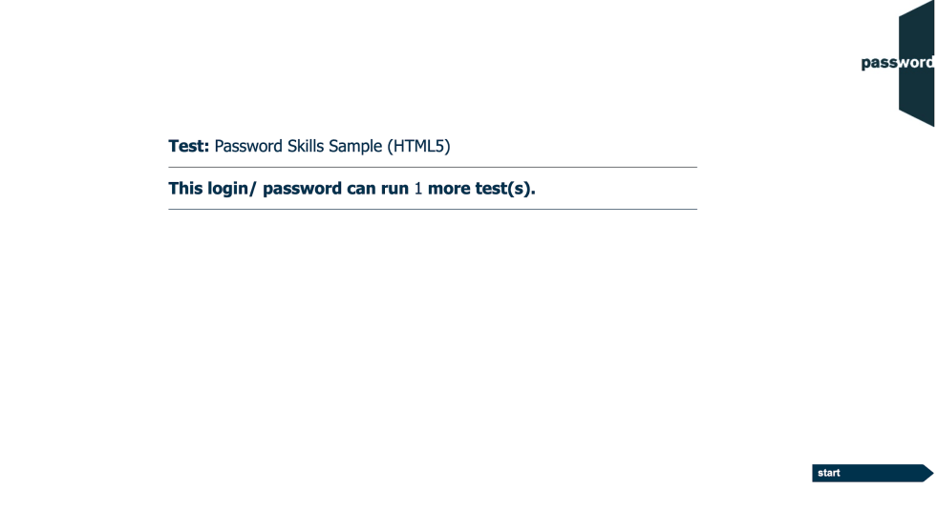
After The Login Page
The invigilator may have already clicked past this page in which case you will not see it.
If you see it, the test name may be different and the number shown should be 1. If it is not 1, alert the invigilator.
Only click on “start” when told to do so by the invigilator.
Notes:
KRW
S
SR

Slide 6

Welcome Screen
On display before you start the test, the actual appearance in your test may be slightly different.
Only click on “continue” when told to do so by the invigilator.

Slide 7
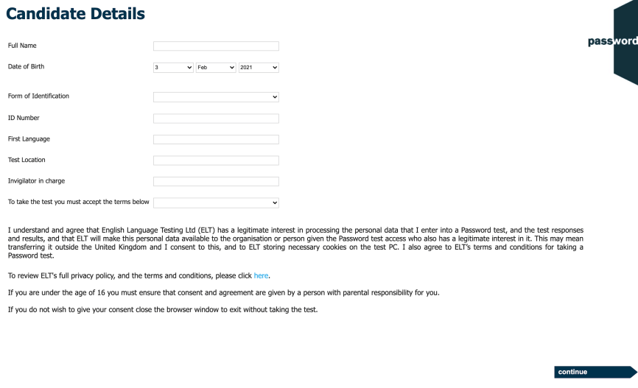
Candidate Details
Carefully complete this section with information about yourself, it cannot be changed later.
The invigilator will instruct you how to fill in the identification details and test location.
There may be more fields, if there are the invigilator will instruct you how to fill them in.
Move the keyboard out of the way, only the mouse is needed until you reach the Writing module of the test. Especially do not press the “special” keys (CTRL, ALT, Win etc.) this will interrupt the test.
WAIT for the invigilator to check your details and only click on “continue” when told to do so.
Notes:
PKW, PYKW, S, SS, KW, K

Slide 8
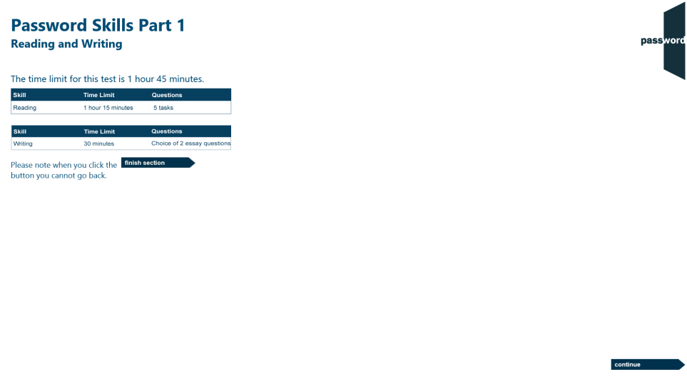
Part 1 Information
Click on “continue” (screen bottom right ) to move forward in the test.

Slide 9
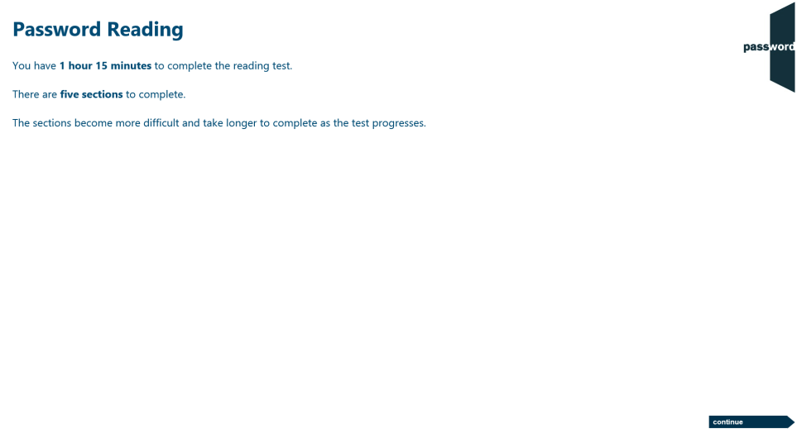
Reading Test Information
1 hour 15 minutes to complete the reading test.
5 reading test sections which get progressively harder.
When you finish a section you cannot return, make sure you have answered all the questions in all the tasks in the section.
Do not use the keyboard in this test.
Click on “continue” (screen bottom right ) to move forward in the test.

Slide 10
Five Reading Test Sections
drag and drop six sentences into the correct order to make a story.
drag and drop seven words into gaps to complete a text.
read a text, then answer eight multiple choice questions about it.
read a text, then select seven headings for paragraphs in the text from drop down lists.
read a text, then drag and drop seven sentences into the correct order to summarise the text.

Slide 11
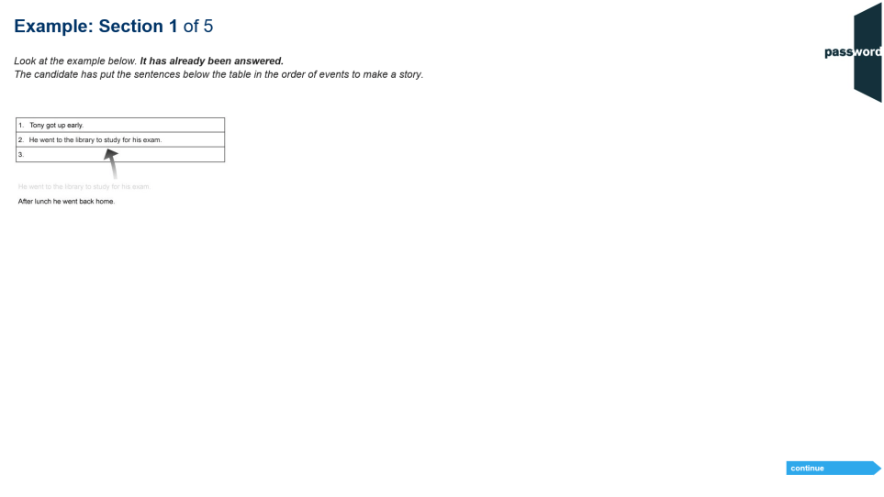
Example - Reading Section 1
Each section has an example screen showing the task format.
In section 1 “drag and drop” the sentences into the table boxes in the correct order to make a story.

Slide 12
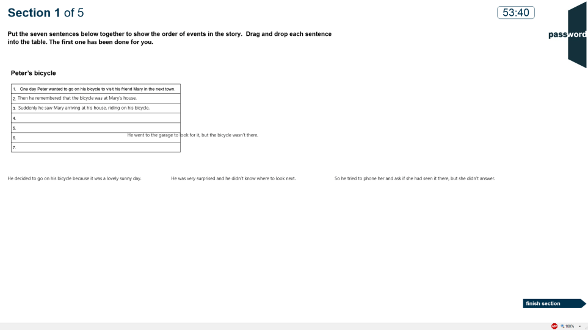
Reading Section 1
There is a clock showing the test time left.
“Drag and drop” each sentence into the table boxes in the correct order to make a story.

Slide 13
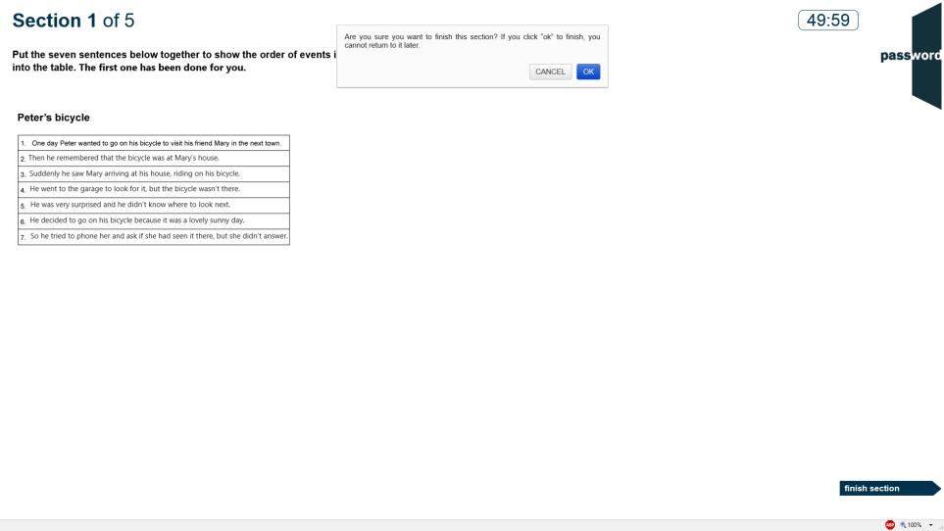
End of Reading Section 1
When you have answered the question, click on “finish section” to move to section 2. You will get a warning that you cannot return to this section later. Click on “CANCEL” to stay in section 1 or “OK” to continue to section 2.

Slide 14
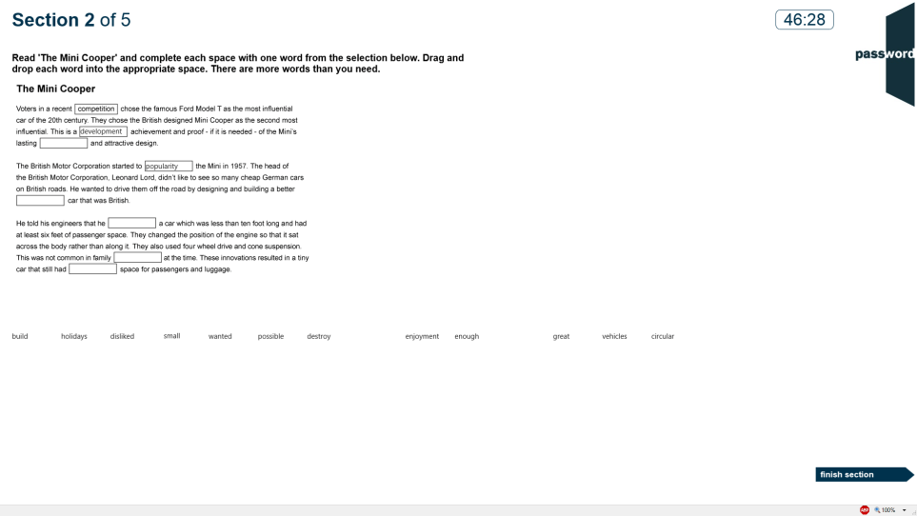
Reading Section 2
“Drag and drop” the words into the correct boxes to complete the text. There are more words than boxes.

Slide 15
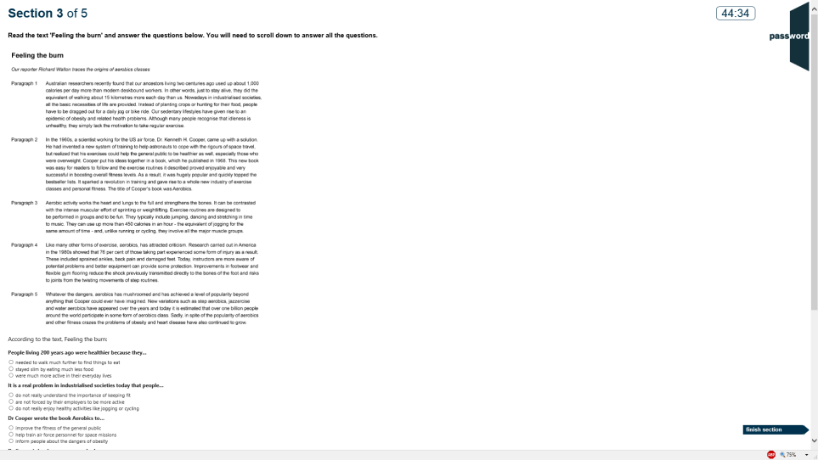
Reading Section 3
Read the text then click on the correct answers to the questions.
You will need to scroll down to see all the questions.

Slide 16
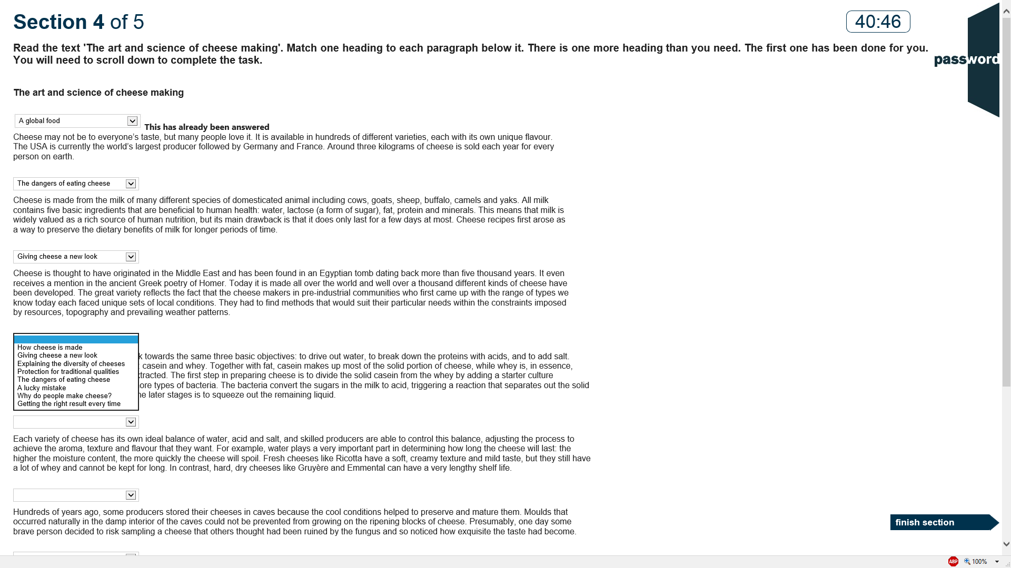
Reading Section 4
Read the text and give a title to each paragraph by clicking on the correct answer in the drop down list.

Slide 17
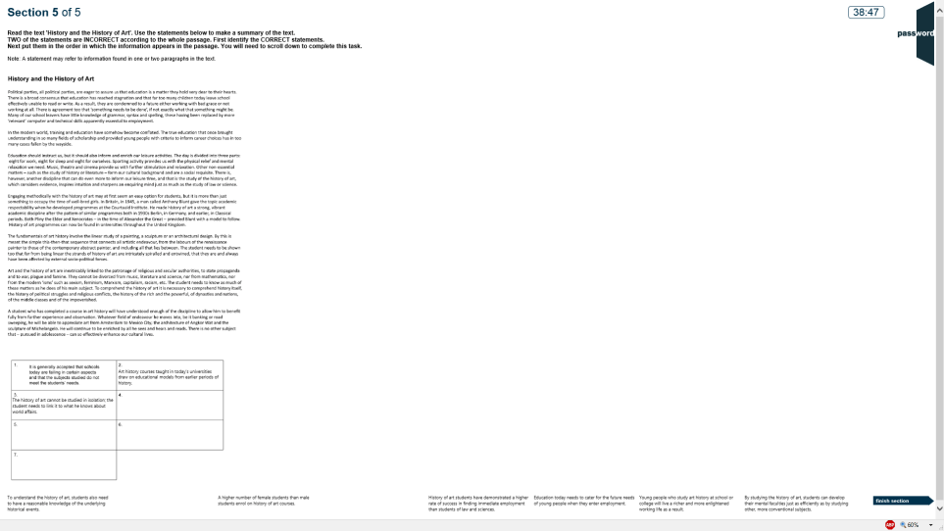
Reading Section 5
Read the text then “drag and drop” the answer texts into the boxes in the right order to make a summary.
There are more texts than boxes.

Slide 18
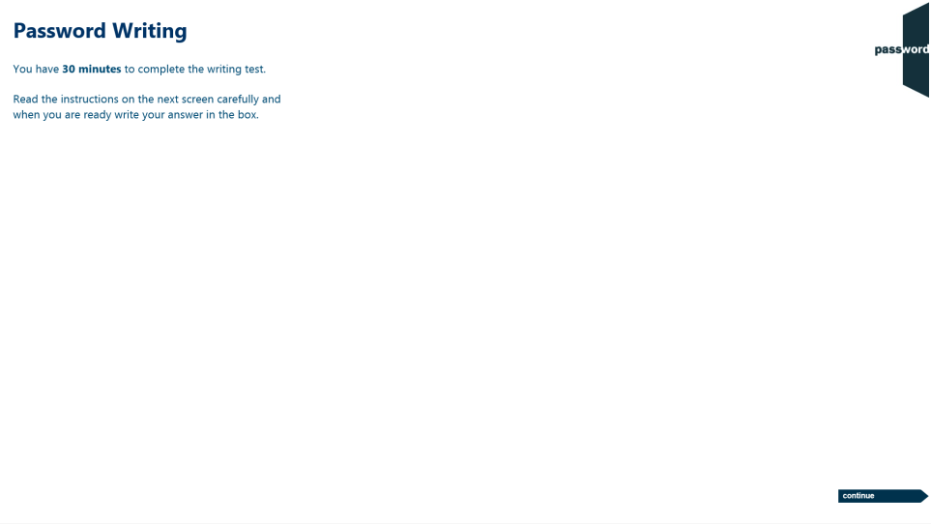
Writing Test Information
1 section in the Writing test.
30 minutes to complete the Writing test.
The keyboard is needed in this test. Do not press of the “special” keys (CTRL, ALT, Win etc.).
Position the keyboard so you can use it comfortably, remember to only use only letters, numbers & symbols.

Slide 19
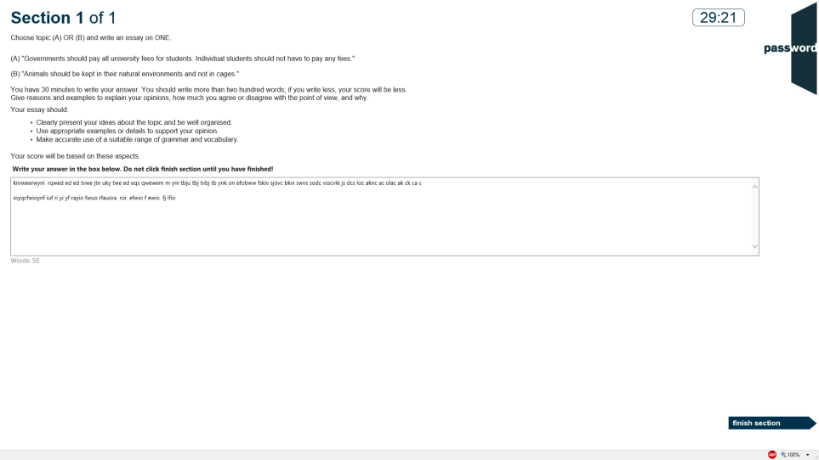
Writing Section
Choose 1 of the 2 essay questions to answer, then type your essay in the box. You do not need to type the question. There is a word counter below the box.
You should write more than two hundred words. Give reasons and examples to explain your opinions, how much you agree or disagree with the point of view, and why. Your essay should clearly present your ideas about the topic and be well organised, use appropriate examples or details to support your opinion and make accurate use of a suitable range of grammar and vocabulary.
Do not click on “finish section” until you have completed your essay.
Notes:
K,KW
KRW
PKW
S

Slide 20
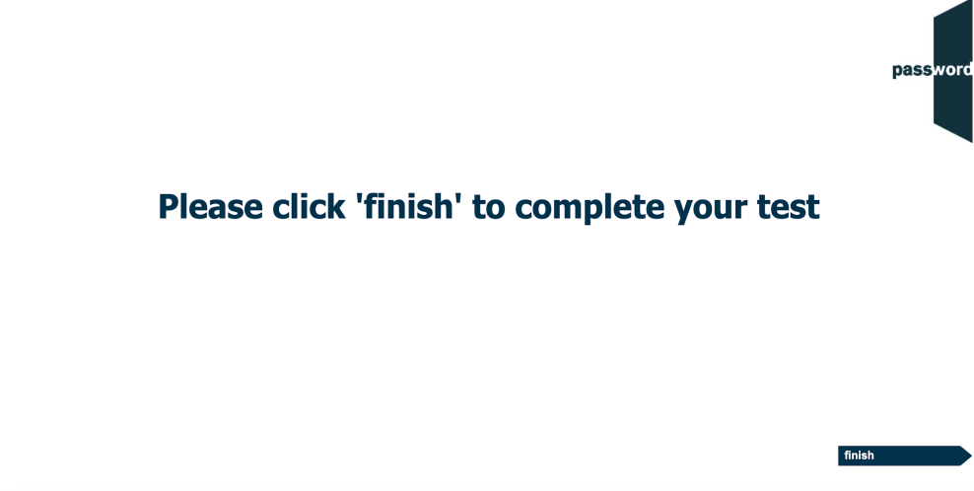
Exit Part 1
Click on “continue”.
Please note, if your test is a one-part test you will not see this screen and your test will continue straight to the next module (see slide 25).
Notes:
S, SS

Slide 21
Login Page
Again the invigilator may have already entered the login details in which case you will not see this page.
Otherwise, enter the SAME login and password as for Part 1 of the test. Only click on “login” when told to do so by the invigilator.
Do not click on “check attempts remaining”.
Notes:
KRW
S, SS
SR

Slide 22
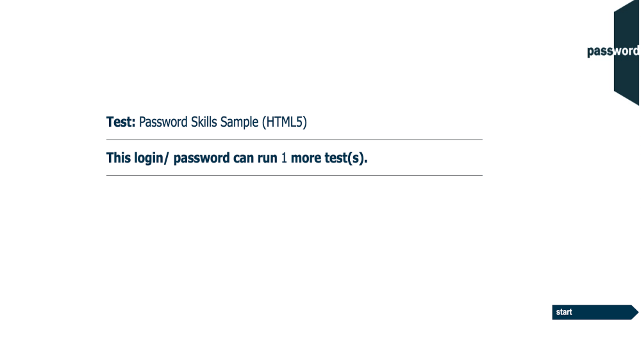
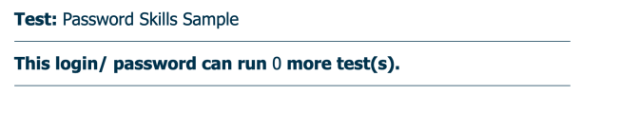
After The Login Page
The invigilator may have already clicked past this page in which case you will not see it.
If you see it, the test name may be different and the number shown should be 0. If it is not 0, alert the invigilator.
Only click on “start” when told to do so by the invigilator.
Notes:
S, SS

Slide 23
Welcome Screen
Displayed before you start the test, the actual appearance in your test may be slightly different.
Again move the keyboard out of the way, only the mouse is needed in Part 2.
Only click on “continue” when told to do so by the invigilator.
Notes:
S, SS

Slide 24
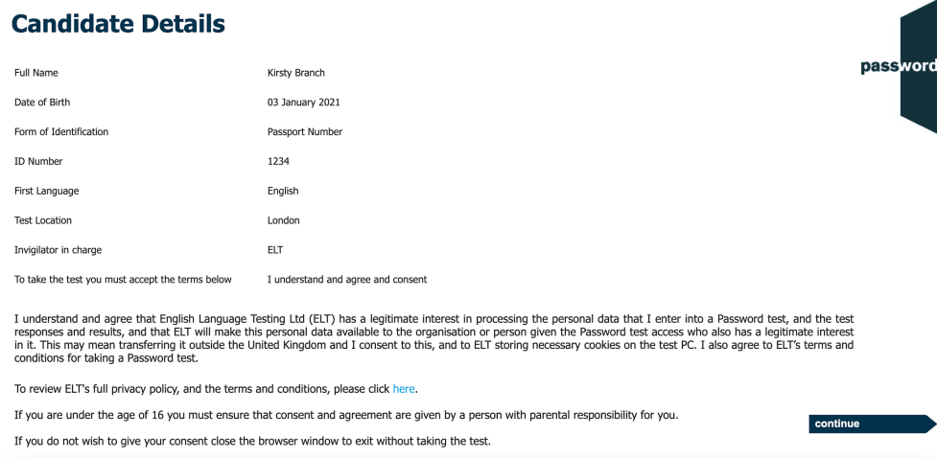
Candidates Details
Check your name etc. are as entered on Part 1.
If they match click on “continue” when told to do so, otherwise alert the invigilator.

Slide 25
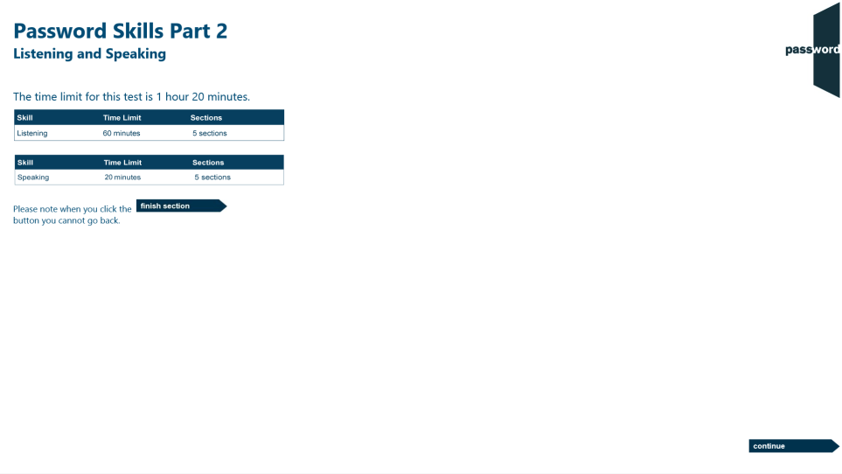
Part 2 Information
In Part 2 you will have a whiteboard to make notes and help you prepare your answers.
These MUST be returned to the invigilator at the end of the test.

Slide 26
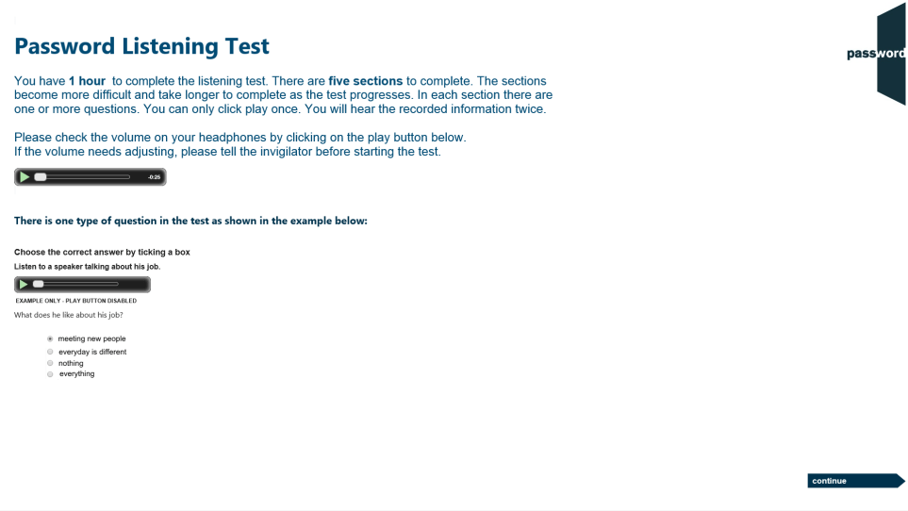
Listening Test Information
5 sections which get progressively harder. 1 or more tasks in each.
First test your headphone volume; click on the green arrow to play the sound file.
Do not use the keyboard in this test.

Slide 27
Five Listening Test Sections
ten tasks with (~30 seconds) recordings of information, messages, lecture clips etc. with a single multiple choice question on each.
one task with a (~three minutes) recording of information such as a lecture, choose if (according to the recording) eight points are correct, incorrect or not mentioned.
six tasks with (~30 seconds) recordings of information, messages, lecture clips etc. with a single multiple choice question on each.
one task with a (~five minutes) recording of information such as a lecture, with six questions, each with one or two answers.
one task with a (~four minutes) recording of two speakers with different views on a topic, choose the four points (from ten) which are mentioned by each.

Slide 28
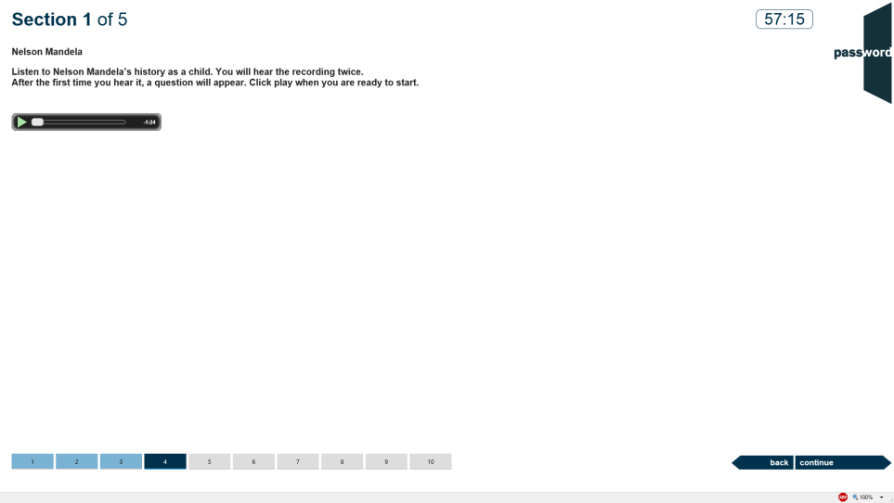
Listening Section 1 Task Start
If a section has more than one task, then the same number of tiles appear at the bottom of the screen. The current task’s tile is dark blue, answered tasks’ tiles are light blue and unanswered tasks’ tiles are light grey. Section 1 has 10 tasks each with a short recording and 1 question on it.
Click on the green arrow to hear the task’s recording. It can only be started once and cannot be paused. After playing the first time the question appears and the recording repeats.
Click on the next tile or “continue” to move to the next task (and “back” to return to a previous task).

Slide 29

Listening Section 1 Task Middle
After the recording has played once, the question appears and you will hear the same recording again.
To answer, click on your answer choice as in Part 1.
Listen and decide your answer.

Slide 30
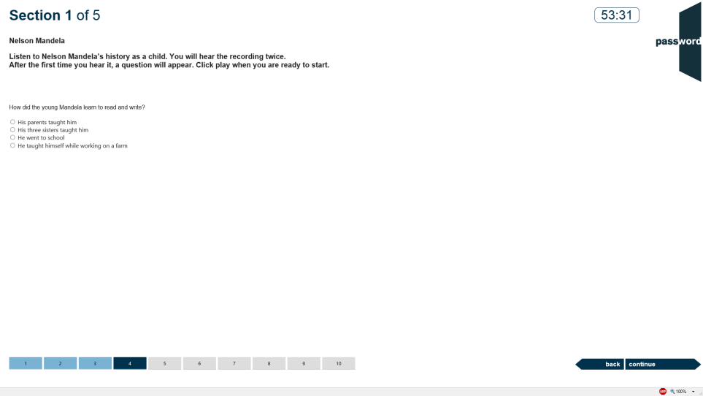
Listening Section 1 Task End
The recording can only be started once and cannot be paused, the player will disappear when the recording has played twice.
Click on your answer choice.
After you have answered, click on the next tile or “continue” to move forward to the next task.

Slide 31
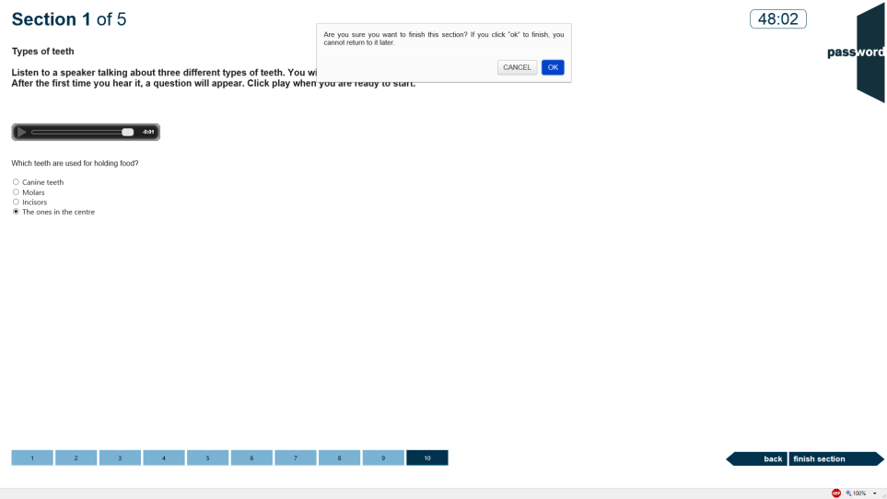
End of Listening Section 1
The test is now on the last task of the listening section (the tile is dark blue), the answered tasks’ tiles are light blue and there are no unanswered tasks.
You can go back and review your answers (though you cannot hear the recordings again) or click on “finish section” & “OK” to move to the next section. When you do this you cannot return to this section later.

Slide 32
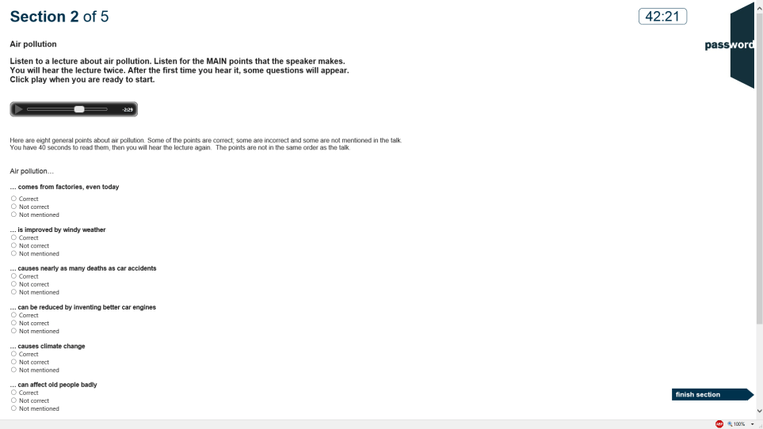
Listening Section 2
Section 2 has 1 task with a longer recording and 8 questions on it. For each you must chose if the statement (according to the recording) is correct, not correct or not mentioned.
After the recording has played once the questions appear and you will hear the same recording again.
Listen and decide your answers.

Slide 33
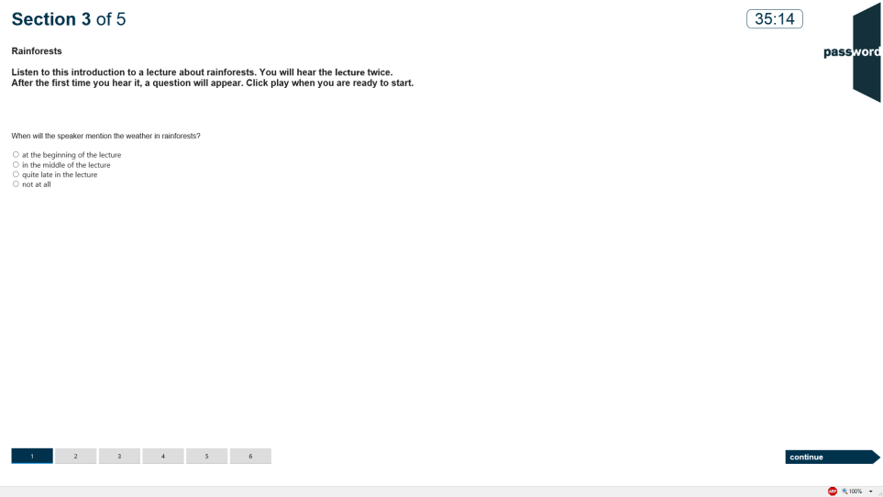
Listening Section 3
Section 3 has 6 tasks each with a short recording and 1 question.
After the recording has played once the question appears, and you will hear the same recording again.
Listen and decide your answer.

Slide 34
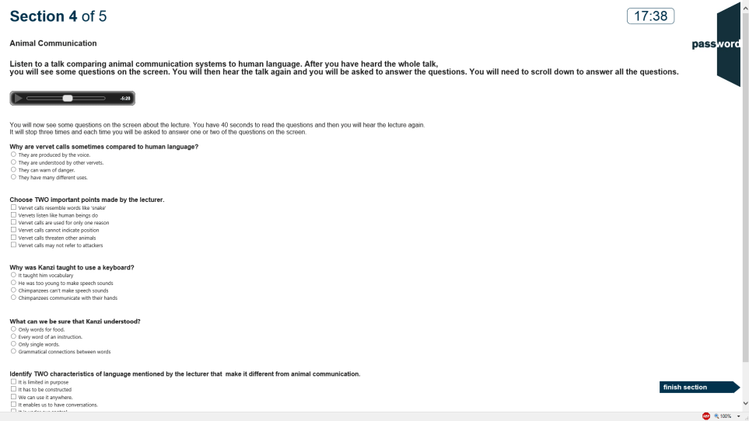
Listening Section 4
Section 4 has 1 task with a longer recording and 6 questions on it. Some questions have two answers to choose.
After the recording has played once the questions appear and you will hear the same recording again.
Listen and decide your answers

Slide 35
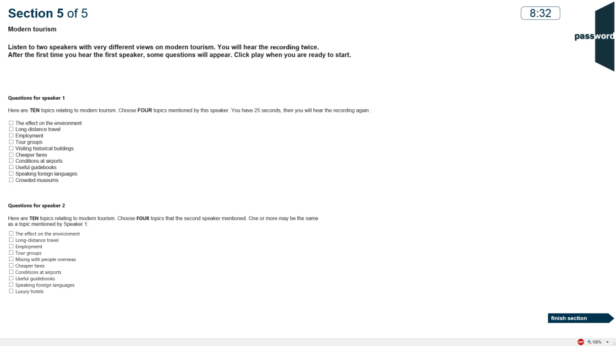
Listening Section 5
Section 5 has 1 task with a longer recording of two different speakers and 2 questions. To answer, tick the boxes for the 4 topics mentioned by each speaker.
After the recording has played once the questions appear and you will hear the same recording again.
Listen and decide your answers.

Slide 36
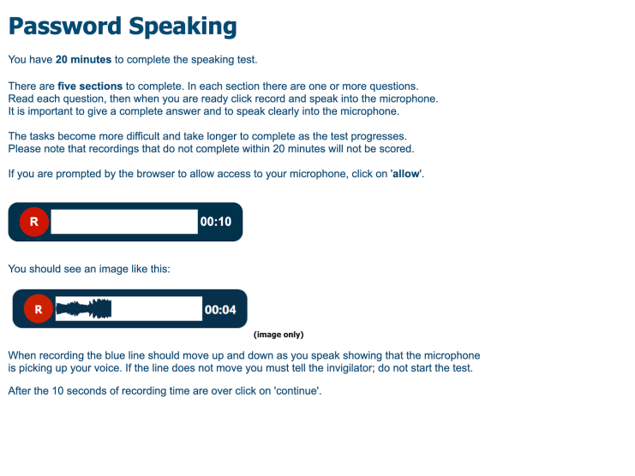
Speaking Test Information
5 sections, 1 or more tasks in each.
The time you are expected to speak increases in each section. You should spend roughly the same amount of time preparing your answer before you speak.
First test your microphone is recording; click on the red button and speak. If red line doesn’t move, alert the invigilator.
There is a 20 minute overall time limit and all recordings must complete within the 20 minutes (otherwise they are not scored).
Do not use the keyboard in this test.
Notes:
S

Slide 37
Five Speaking Test Sections
simply state your name, date of birth and read a short text from the screen in 30 seconds.
five tasks with questions about you, with 20 seconds answer time each.
three tasks with questions on situations you might might find yourself in, with 45 seconds answer time each.
one task to argue for or against a proposition, with one minute answer time.
one task to analyse and extrapolate from information presented (such as a graph), with two minutes answer time.

Slide 38
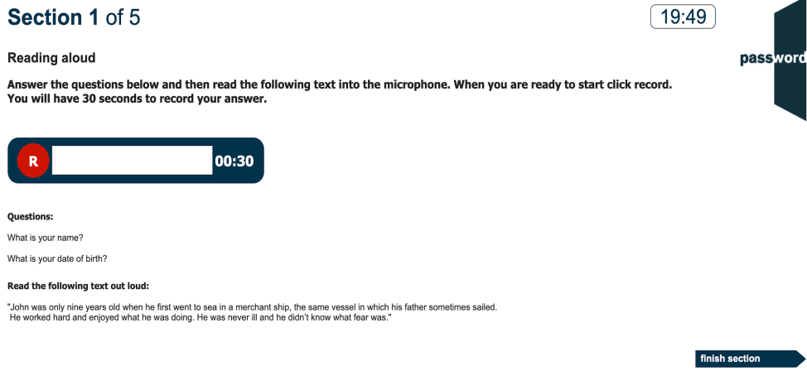
Speaking Test Section 1
Read the questions, prepare your answers bearing in mind the 30 seconds speaking time allowed, then click on the red button and speak your answers to the questions and read the text out loud. If the red line does not move up and down as you speak, alert the invigilator.
You cannot re-record your answers.
You cannot continue to the next section until the speaking time is up; you may see a message that “encoding” or “uploading” is taking place and this must also finish before you can continue.
Notes:
S

Slide 39
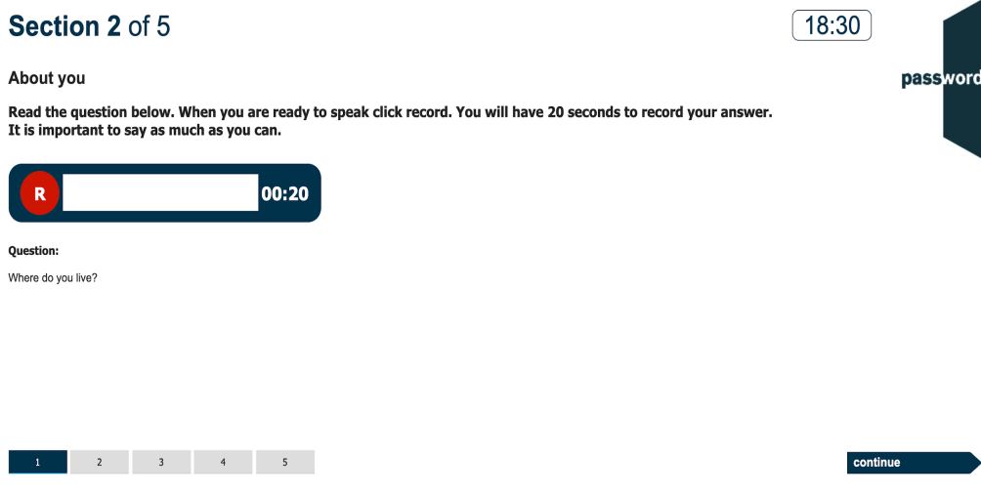
Speaking Test Section 2
For the 5 tasks, read the question, prepare your answer bearing in mind the 20 seconds speaking time allowed, then click on the red button and speak your answer.
You cannot re-record your answers.
You cannot continue to the next task until the speaking time is up; you may see a message that “encoding” or “uploading” is taking place and this must also finish before you can continue.
Notes:
S

Slide 40
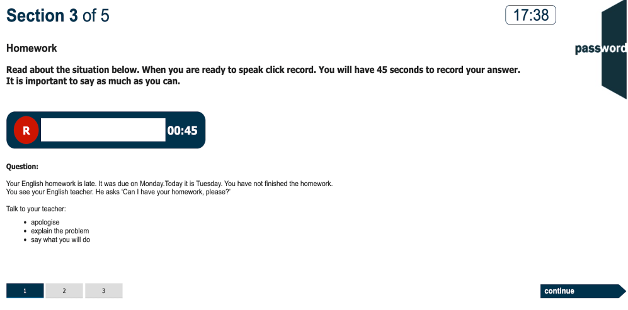
Speaking Test Section 3
For the 3 tasks, read the question, prepare your answer bearing in mind the 45 seconds speaking time allowed, then click on the red button and speak your answer.
You cannot re-record your answers.
You cannot continue to the next task until the speaking time is up; you may see a message that “encoding” or “uploading” is taking place and this must also finish before you can continue.
Notes:
S

Slide 41
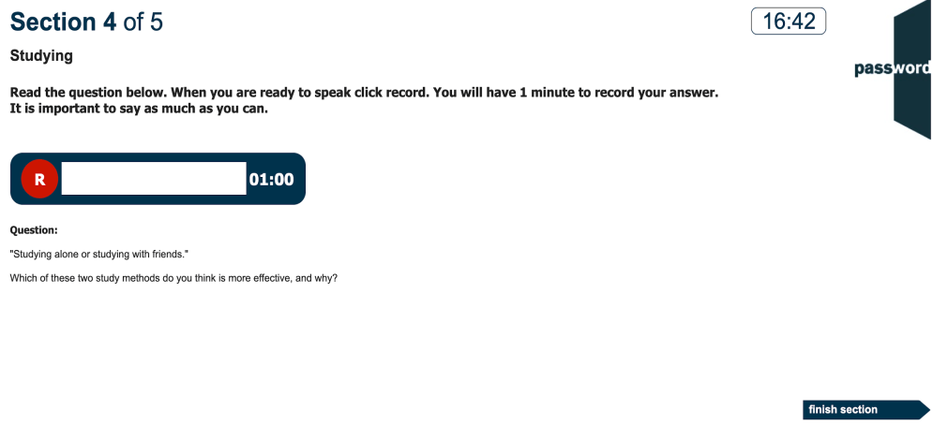
Speaking Test Section 4
Read the question, prepare your answer bearing in mind the 1 minute speaking time allowed, then click on the red button and speak your answer.
You cannot re-record your answer.
You cannot continue to the next task until the speaking time is up; you may see a message that “encoding” or “uploading” is taking place and this must also finish before you can continue.
Notes:
S

Slide 42
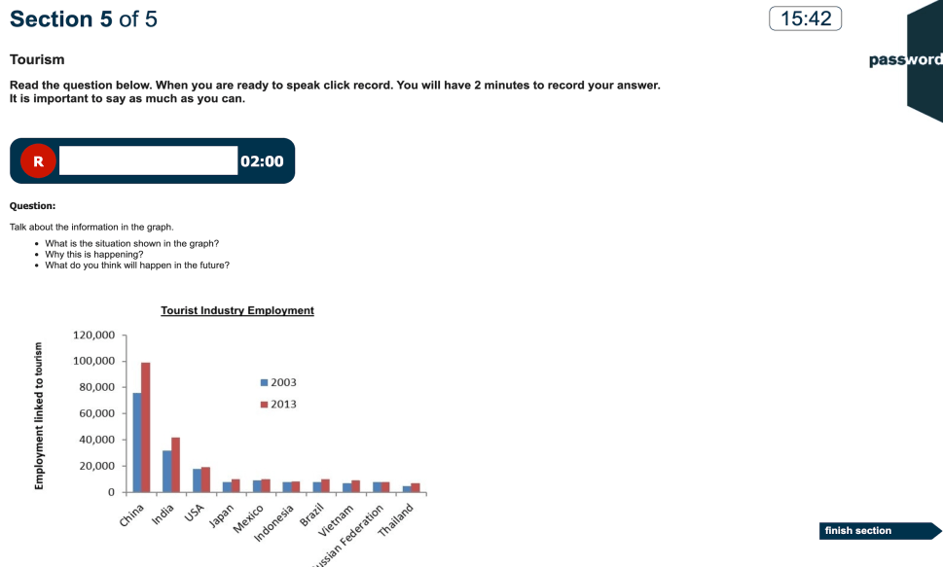
Speaking Test Section 5
Read the question, prepare your answer bearing in mind the 2 minutes speaking time allowed, then click on the red button and speak your answer.
You must start recording before the clock reaches 18 minutes.
You cannot re-record your answer.
You cannot finish the section until the speaking time is up; you may see a message that “encoding” or “uploading” is taking place and this must also finish before you can continue.
Notes:
S

Slide 43
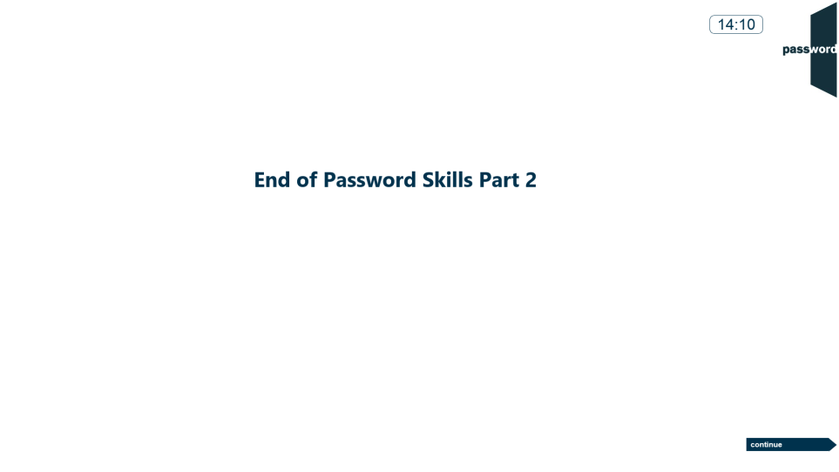
End Of Part 2

Slide 44
Exit

Slide 45


Password Test Security
Password tests prevent cheating by detecting access to anything outside of the test, including “pop ups”. Such access is judged to be an attempt to cheat and the test is interrupted.
Tests run in “full screen” mode, so access to anything outside of the test can only happen if “special” keys are pressed (including "Win" ( or ), "Ctrl" ( ), "Alt" ( ) & function keys). Do not do this!
You only need the keyboard to enter your candidate details at the beginning of the test, and during the Writing test if there is one. ONLY use keyboard letters, numbers & symbols.
If you press these special keys you risk having your test interrupted.

Slide 46
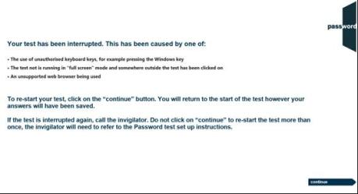
Password Test Security
If the test is interrupted the following screen will appear:
If this happens you can click on the continue button and restart the test, though some test time may be lost. Most answers will have been saved but answers to questions in the section being worked on at the time the test was interrupted may need to be re-entered, and also the most recent parts of an essay.
If the test is interrupted again alert the invigilator as there may be a problem with the set up of the test PC.
Notes:
K,KW
KRW
S
SR

Slide 47
Good luck!

