Slide 1
Taking the
Password Maths
Test
Notes:
M

Slide 2
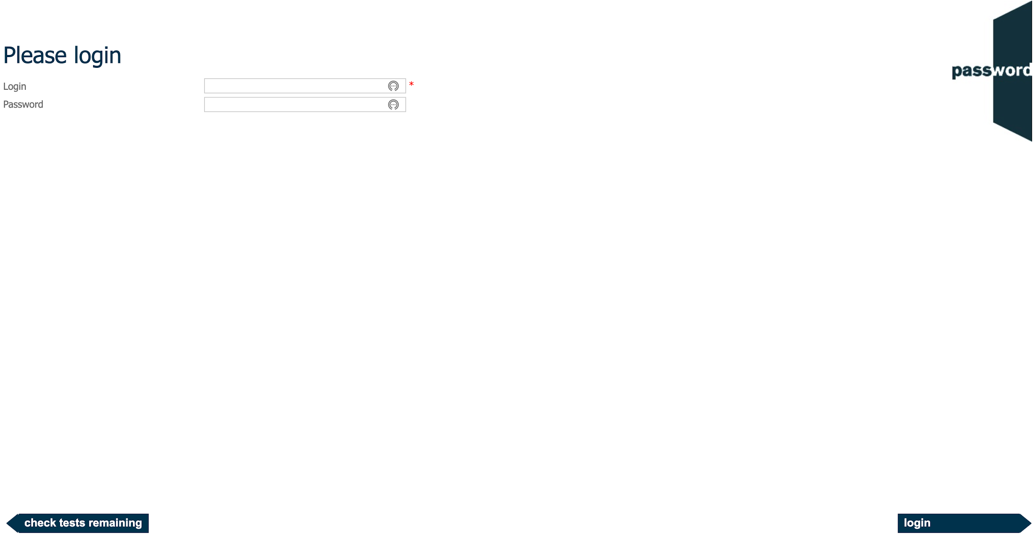
Login Page
The invigilator may have already entered the login details in which case you will not see this page.
Otherwise, enter the login and password as instructed by the invigilator. Only click on “login” when told to do so by the invigilator.
Do not click on “check tests remaining”.
Notes:
K,KW
KRW
S
SR
M

Slide 3
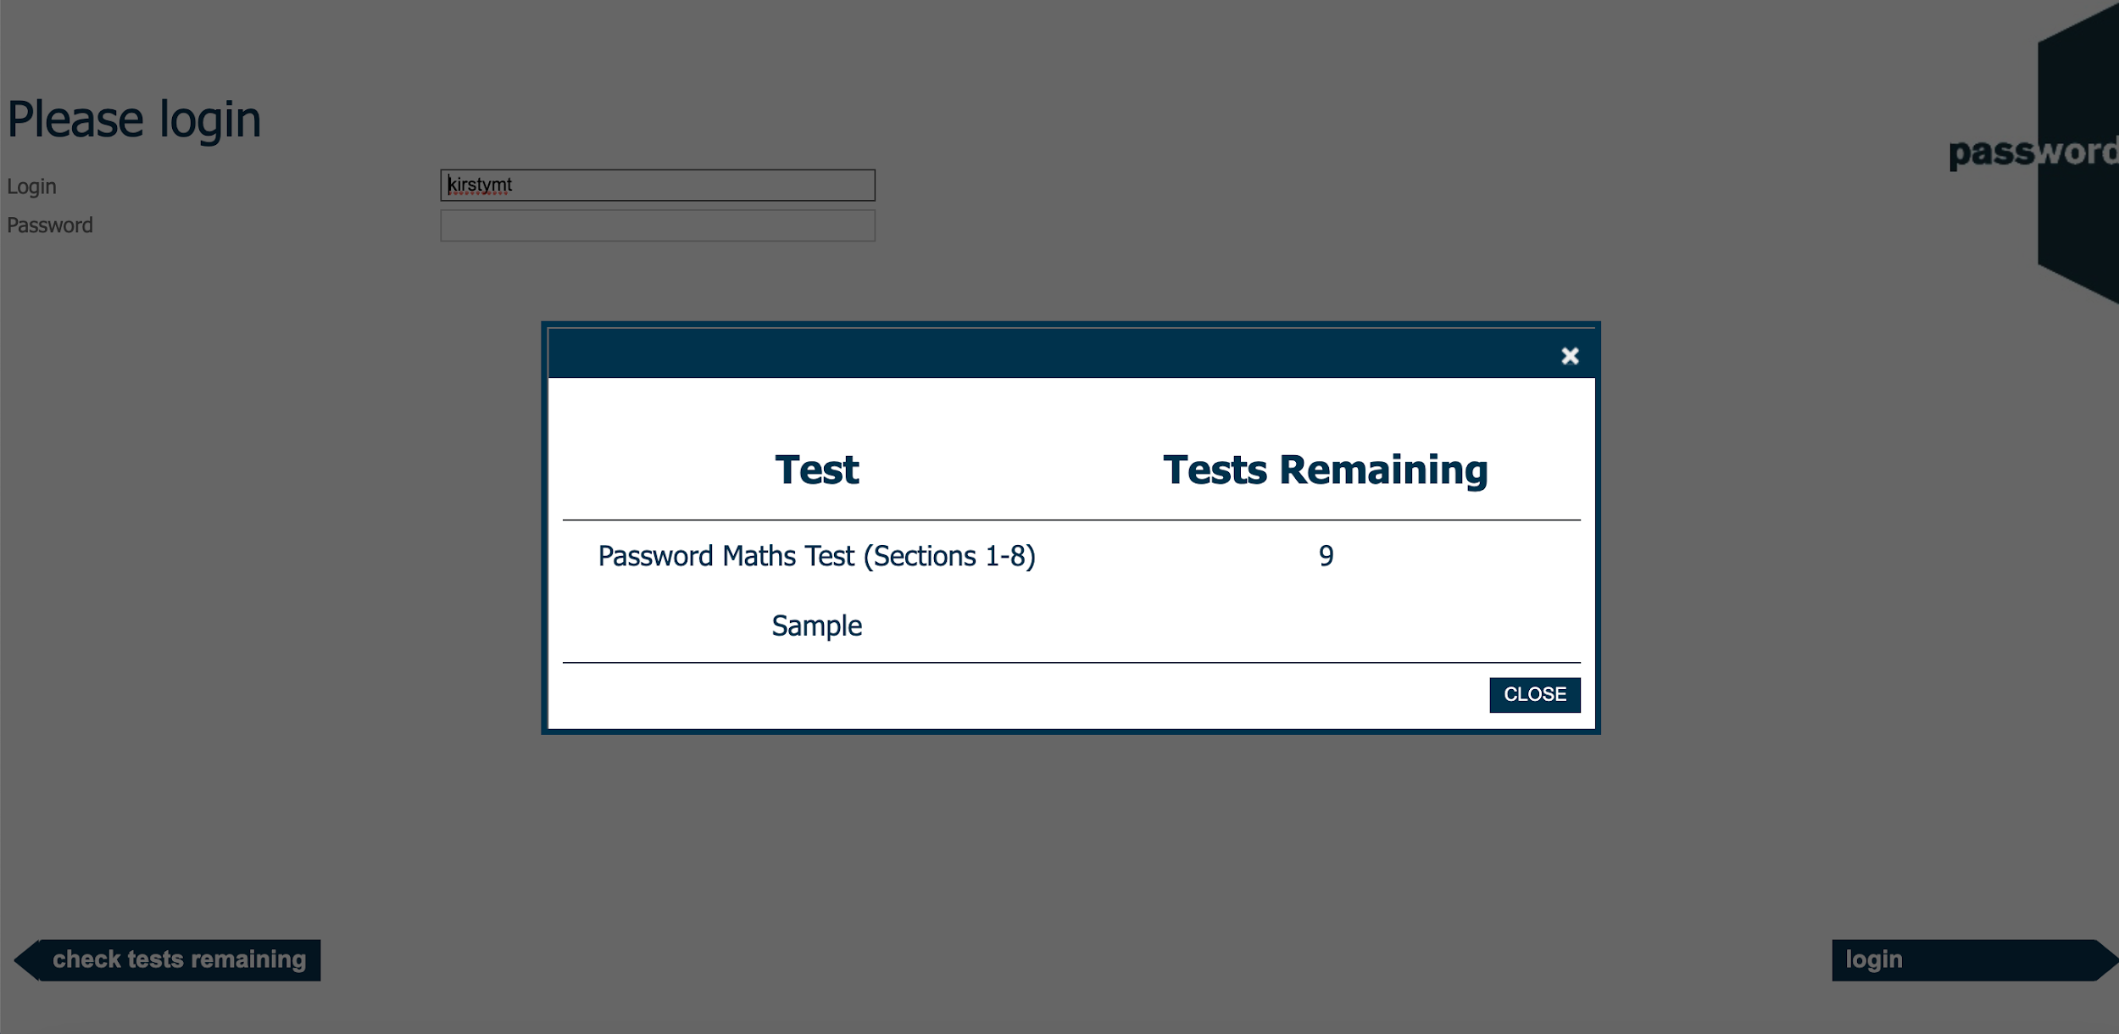
Tests Remaining Page
If you click on “check attempts remaining” by mistake, you will see a page like this (the name of your test may be different).
Click on the “X” or “CLOSE” to return to the login page.
Notes:
M

Slide 4
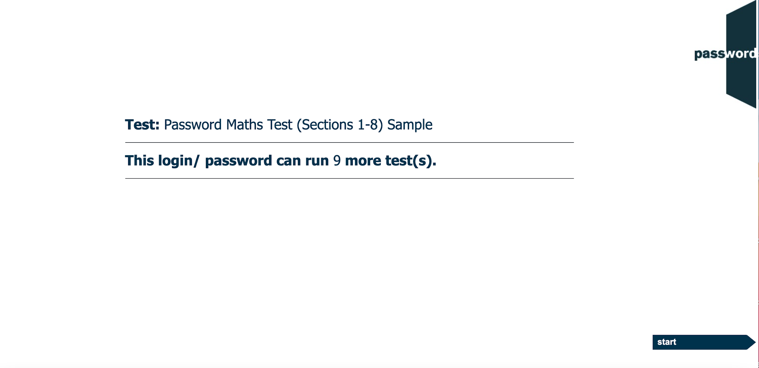
After The Login Page
The invigilator may have already clicked past this page in which case you will not see it.
If you see it, the test name and the number shown may be different.
Only click on “start” when told to do so by the invigilator.
Notes:
M

Slide 5
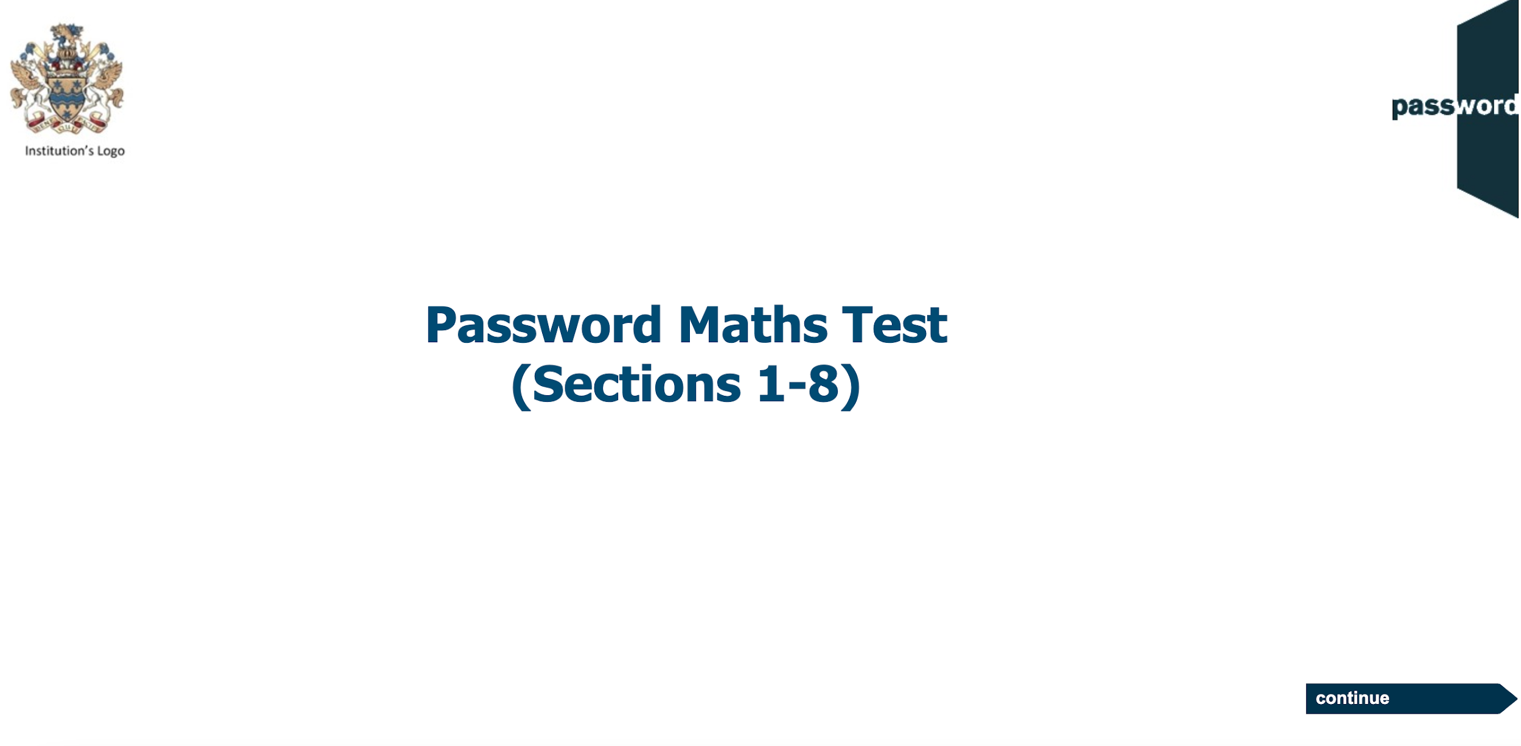
Welcome Screen
Displayed before you start the test, the actual appearance in your test may be slightly different.
Only click on “continue” when told to do so by the invigilator.
Notes:
M

Slide 6
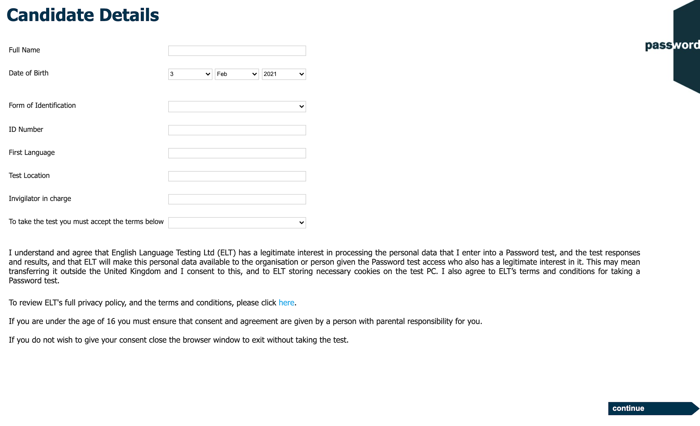
Candidate Details
Carefully complete this section with information about yourself, it cannot be changed later.
The invigilator will instruct you how to fill in the identification details and test location.
There may be more fields, if there are the invigilator will instruct you how to fill them in.
To take the test you must agree to the data privacy policy & conditions for taking the test by selecting “I agree” from the drop down.
Do not press the “special” keys (CTRL, ALT, Win etc).
WAIT for the invigilator to check your details and only click on “continue” when told to do
so.
Notes:
K, KW
PKW
P(Y)KW
S, SS

Slide 7
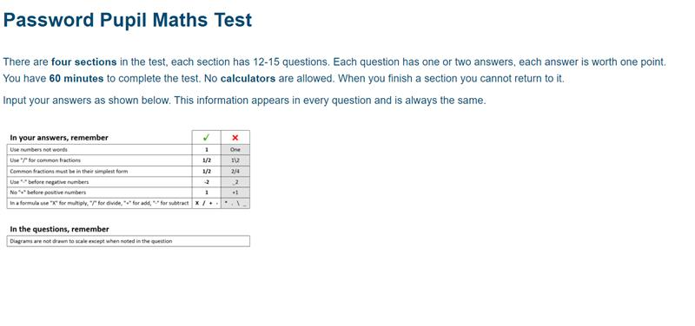
Maths Test Information (1)
1 hour to complete the test.
4 test sections, which get progressively harder, with 12 - 15 questions in each.
No calculators are allowed.
The same information on inputting answers shown appears in every question.
Notes:
M

Slide 8
Maths Test Information (2)
Position the keyboard so you can use it comfortably, use only letters, numbers & symbols. Do not press any of the “special” keys (CTRL, ALT, Win etc.), this will interrupt your test and you may be logged out.
When you finish a section you cannot return, make sure you have answered all the questions in the section.
Click on “continue” (screen bottom right) to move forward in the test.
Notes:
M

Slide 9
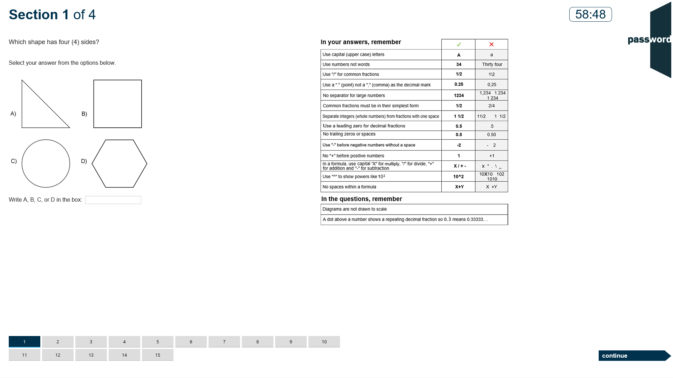
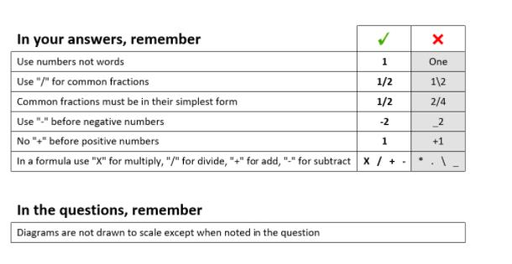
Maths Test Sections
There is a clock showing the test time left in the test.
Each section has 14 or 15 questions (15 here) with the same number of tiles at the bottom of the screen. The current question’s tile is dark blue, answered questions’ tiles are light blue and unanswered questions’ tiles are light grey.
Click on the next tile or “continue” to move to the next question (and “back” to return to the previous one).
Notes:
M

Slide 10
Maths Question Type 1
Answer questions in two ways. With a multiple choice question, select your answer A, B, C or D and enter A, B, C or D in the box. In this example the answer is B.
Notes:
M

Slide 11
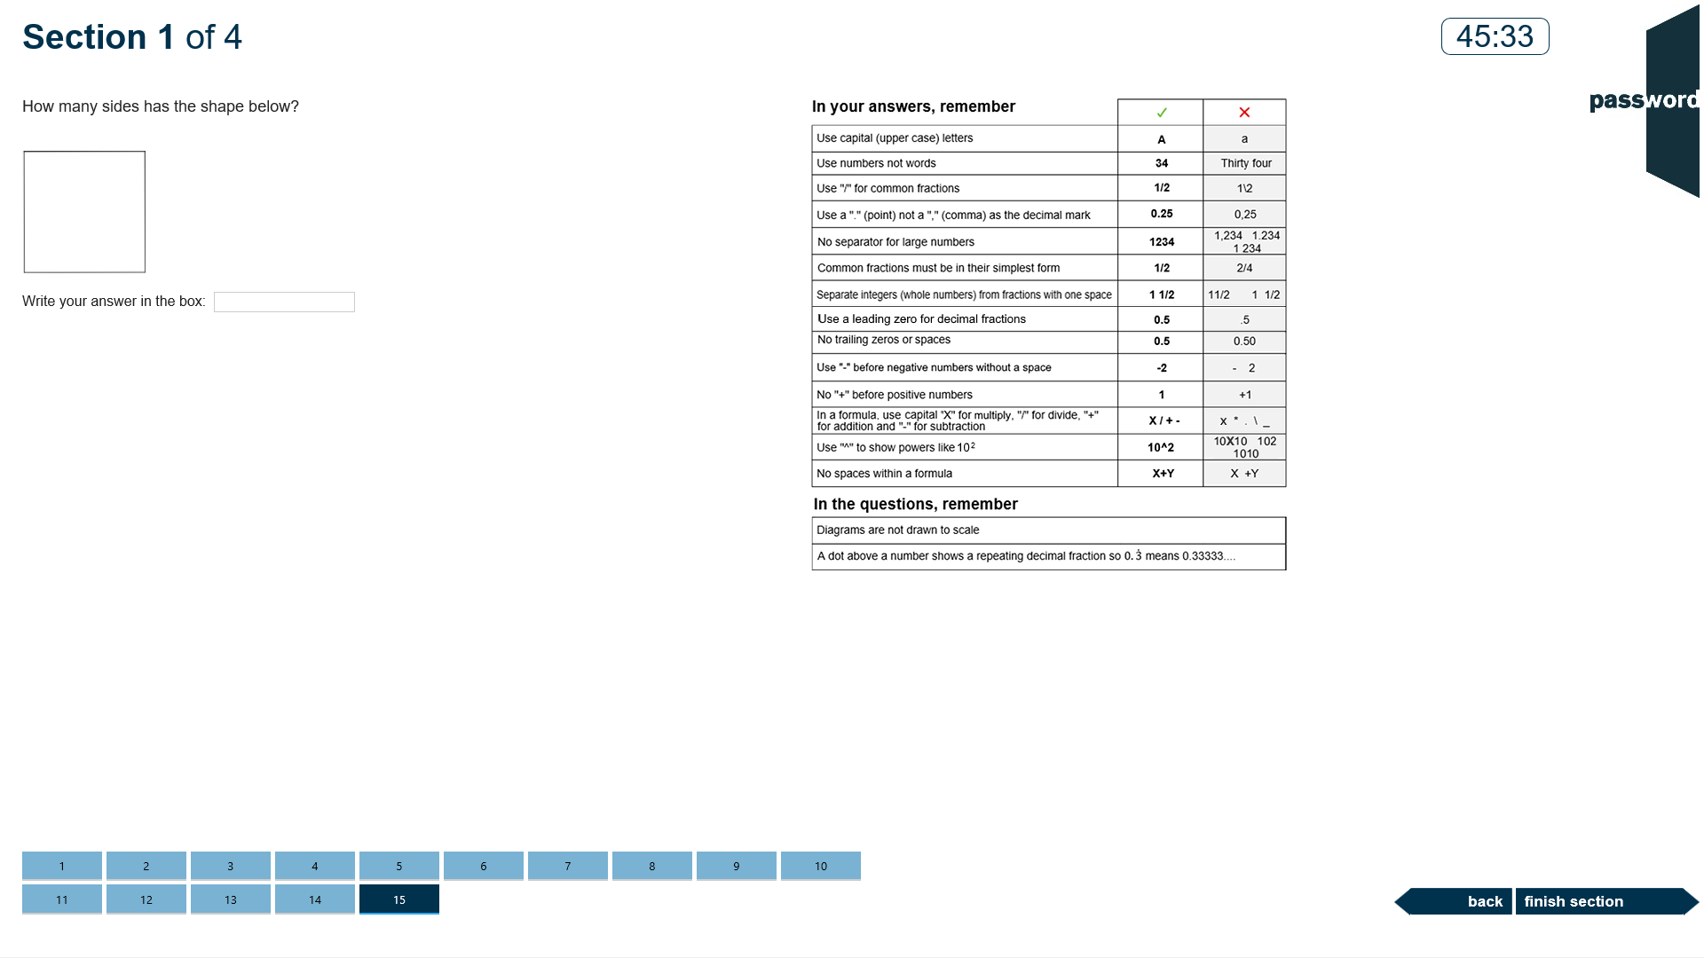
Maths Question Type 2
In the second type of question enter the number or formula in the box. In this example the answer is 4.
Notes:
M

Slide 12
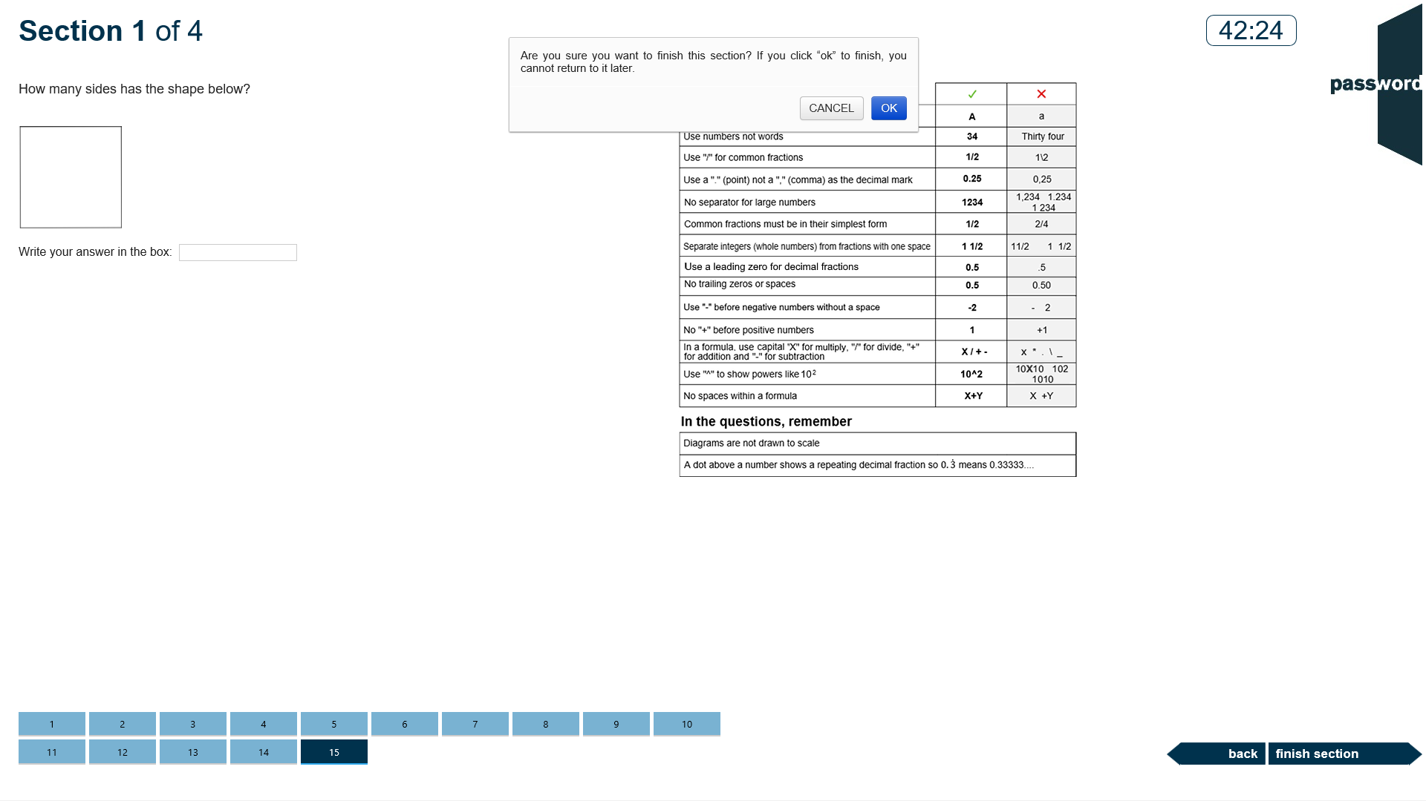
End of Maths Section 1
The test is now on the last question of section 1 (tile 15 is dark blue), the answered questions’ tiles are light blue.
You can go back and review your answers or click on “finish section” to move to section 2. When you do this you will get a warning that you cannot return to this section later. Click on “CANCEL” to stay in section 1 or “OK” to continue to section 2.
Notes:
M

Slide 13
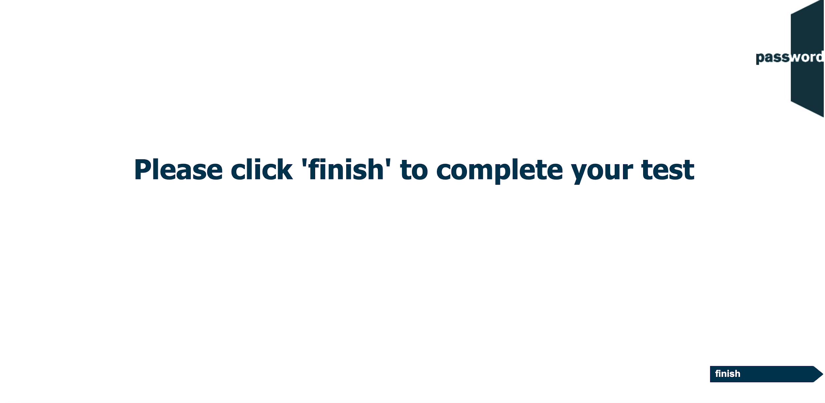
Exit
Notes:
KRW
PKW
P(Y) KW
S, SS
SR
M

Slide 14

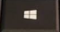


Password Test Security
Password tests prevent cheating by detecting access to anything outside of the test, including “pop ups”. Such access is judged to be an attempt to cheat and the test is interrupted.
Tests run in “full screen” mode, so access to anything outside of the test can only happen if “special” keys are pressed (including "Win" ( or ), "Ctrl" ( ), "Alt" ( ) & function keys). Do not do this!
You only need the keyboard to enter your candidate details at the beginning of the test, and during the Writing test if there is one. ONLY use keyboard letters, numbers & symbols.
If you press these special keys you risk having your test interrupted.

Slide 15
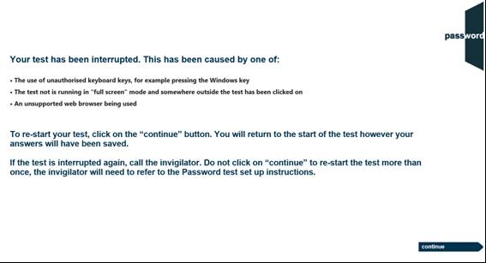
Password Test Security
If the test is interrupted the following screen will appear:
If this happens you can click on the continue button and restart the test, though some test time may be lost. Most answers will have been saved but answers to questions in the section being worked on at the time the test was interrupted may need to be re-entered, and also the most recent parts of an essay.
If the test is interrupted again alert the invigilator as there may be a problem with the set up of the test PC.
Notes:
K,KW
KRW
S
SR

Slide 16
Good luck!
Notes:
K,KW
KRW
PKW
P(Y)KW
S
SR
M

